Slide 1
MARATHWADA SHIKSHAN PRASARAK MANDAL’S VINAYAKRAO PATIL MAHAVIDYALAYA, VAIJAPUR.
Department Of BSC (Computer Science)
Project name : Old Book Reselling System.
Submitted to : BCS Department
Group No. : Group - V
HOD : Prof.Mr.A.B.Thore
Guide : Asst.Prof.Miss.P.S.Joshi.
Submitted by: Gavali Pratap Sainath.
Ghayawat Chetan Ashok.
Harde Abhijit Santosh.

Slide 2
Introduction
In this project we are opening the platform for the peoples where the peoples can sell and buy old books here .
We are developing one user friendly Web application for this purpose. Where peoples can sell and buy books online.
The peoples can also communicate with each other by the contact details that provided by their seller and buyer.

Slide 3
System Requirement Analysis
Need Of Proposed System.
Advantages Of Proposed System.
Software Process Model And Development.
Hardware /Software Specification

Slide 4
Need Of Proposed System
To help peoples who unable to buy a new books.
To provide most costly books in the least price.
Developed for the sell and buy the old books.
Peoples can sell or also buy a old books in 50% price of new price of that book.

Slide 5
Advantages Of This System
Peoples can buy most costly books in least prices.
Peoples can improve their readability.
Can consult with seller and buyer of books.
Can buy or sell of books at one click.

Slide 6
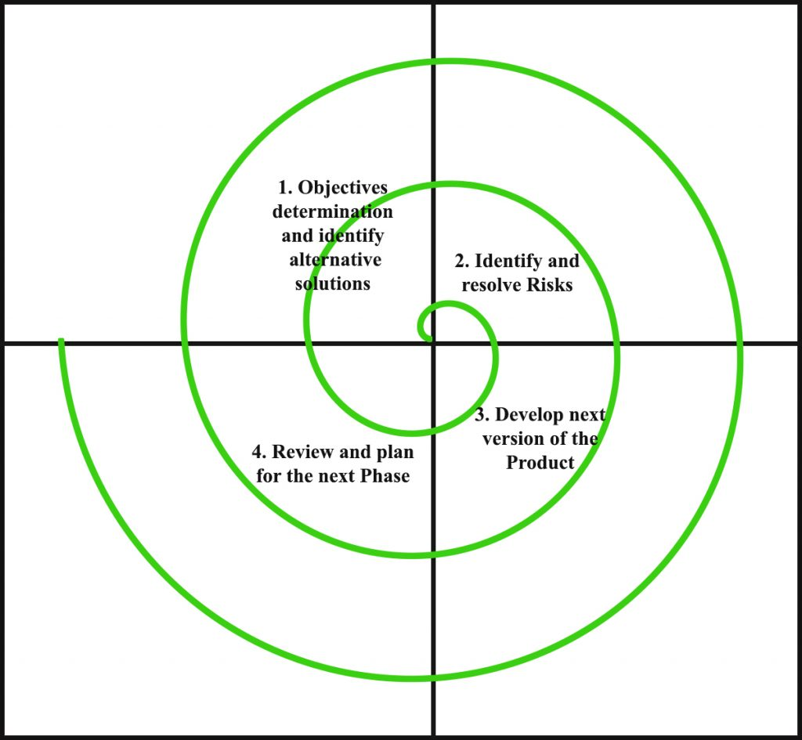
Software Process Model And Development
Spiral Model

Slide 7
Software Specification
Software Specification:
Browser: All Browser.
Database: My Sql Server.
Technologies:
Front End: HTML,CSS ,JavaScript
Back End: MYSQL Server
Server Software Specification:
Processor: 32-bit, 1GHz or Greater.
Ram: Minimum 512mb
HDD: 5GB HDD.

Slide 8
Hardware Specification
Hardware Specification:
Hard disk: 10GB
RAM: 512mb
Processor : Intel Pentium or More.
Server Hardware Specification:
Hard Disk: 15GB.
RAM: 512mb.
Processor:
Minimum 1GHz

Slide 9
Feasibility Study
The feasibility study is a controlled process for identifying problems and opportunities, determining objective, describing situation, defining successful outcomes, assessing the range of costs and benefits associated with alternative for solving problem.

Slide 10
Technical Feasibility
Support Hardware:- Up to 1GHz. processor.
Storage:- 2GB HDD, 250MB RAM.
Supports to all browser.
Operating System:- All GUI OS that able to support any web browser.

Slide 11
Economical Feasibility
Not need costly hardware.
User can save their money.
All charge may apply for benefits.
Low maintenance costs.
paid promotion may be include.

Slide 12
Operational Feasibility
Proved adequate throughput and response time.
Able to provide to users with timely, pertinent, accurate, updated and useful formatted information.
Could able to be a reduction in cost and or an increase in benefits.
Effective controls to protect against fraud and to guarantee accuracy and security of data and information.

Slide 13
Preliminary Design
Visit
Homepage
View book
Registration
Login
Profile
Sell Book
Feedback
Buy Books
Feedback
Logout

Slide 14
Data flow diagram level 0
Online old book reselling
System
Admin
User

Slide 15
Admin Side 1st Level DFD
.
1.0
Login
Admin
AdminDB
2.0
Manage User
UserDB
3.0
Manage Orders
OrderDB
4.0
Manage Reports
Order DB

Slide 16
User Side 1st Level DFD
.
1.0
View/Search Book
User
Book_po_DB
2.0
Registration
UserDB
3.0
Login
UserDB
4.0
Buy Book
Book_Po_DB
5.0
Sell Book
Book_Po_DB
6.0
Make Order
OrderDB

Slide 17
Admin Side 2nd Level DFD
.
1.0
Login
Admin
AdminDB
2.0
Manage User
UserDB
3.0
Manage Orders
OrderDB
4.0
Manage Reports
Order DB

Slide 18
Admin Side 2nd Level DFD (2.0)
.
2.0
Login
Admin
AdminDB
2.1
Manage User
UserDB

Slide 19
Admin Side 2nd Level DFD (3.0)
.
3.0
Login
Admin
AdminDB
3.1
View Orders
Order_DB
3.2
Co/ca Orders
OrderDB
4.0
Manage Posts
Book_po_DB

Slide 20
Admin Side 2nd Level DFD (4.0)
.
4.0
Login
Admin
AdminDB
4.1
User Report
User_DB
4.2
Order Report
OrderDB
4.3
Payment Report
Order_DB

Slide 21
User Side 2nd Level DFD (4.0)
.
4.0
Login
User
UserDB
4.1
View Book
Book_po_DB
4.2
Order Book
OrderDB
4.3
Payment Report
Order_DB

Slide 22
User Side 2nd Level DFD (5.0)
.
4.0
Login
User
UserDB
4.1
Upload Image
Book_po_DB
4.2
Contact Details
Book_po_DB
4.3
New Price
Book_po_DB

Slide 23
Usecase Diagram
Login
Manage User
Manage Orders
Admin
User
Registration
View Books
Order Book
Sell Book
Edit Profile

Slide 24
Activity Diagram For Admin
Login
Authentication
Check
Manage user
Manage post
Manage orders
Delete user
Change status
Conform/
cancle order
Logout

Slide 25
Activity Diagram For User
Login
Authentication
Check
Search Book
Edit Profile
View Report
Sell Book
Buy Book
Change password
Chang mobile.no
Order report
Post report
Cancel Order
Conform Order
Logout

Slide 26
ER- Diagram
Uname
Passwd
U-id
B_Name
B_IMG
Has
RegistrationDB
PostDB
UID
HAS
P_ID
Price
Contact
HAS
O-ID
Price
E-ID
Date
Order-DB
Feedback
Date
C-ID
Email
Contact
Address
Date

Slide 27
Online Old Book Reseling
Table Name
Registration
Book_post
Orders
Feedback
Admin

Slide 28
Registration
Column | Type | Size
ID(Prm) | int | -
Fname | varchar | 50
Lname | varchar | 50
Email | varchar | 20
Mob_no | bigint | -
Address | varchar | 100
Passwd | int | -

Slide 29
Book Post
Colunm | Type | Size
Post_id(Prm) | int | -
B_name | varchar | 20
B_imgae | varchar | 500
email | varchar | 20
New_price | int | -
Curr_price | int | -
Descrip | varchar | 50
S_address | varchar | 50
Mob_no | bigint | -
status | varchar | 20
Mob_no | int | -

Slide 30
Orders
Column | Type | Size
order_id | int | -
name | varchar | 20
email | varchar | 20
Pincode | int | -
Status | varchar | 20
mob_no | bigint | -
addr | varchar | 50
payment | int | -
date | date | -

Slide 31
Feedback
Column | Type | Size
F_id(prm) | int | -
feed | text | -
email | varchar | 20
date | date | -

Slide 32
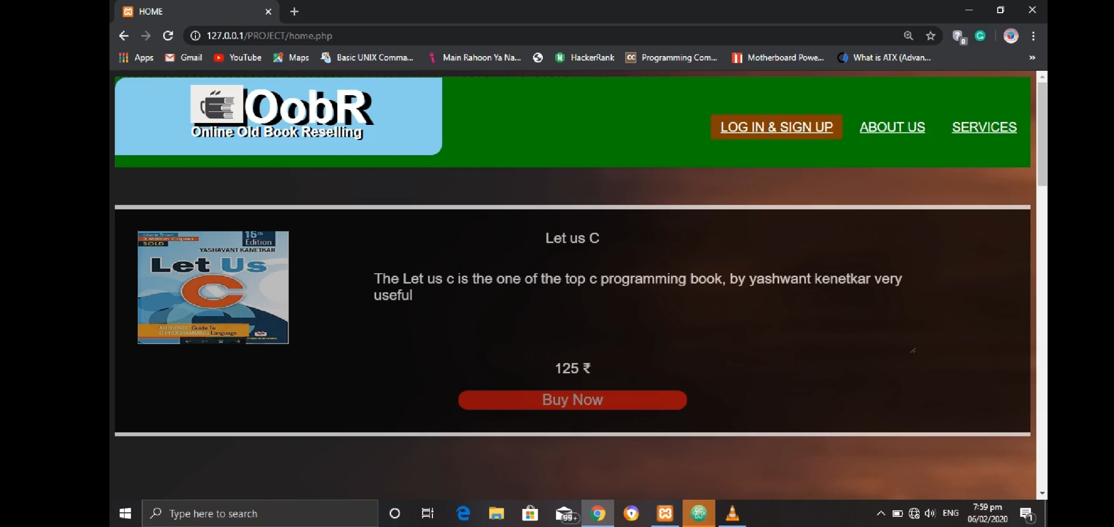

Slide 33
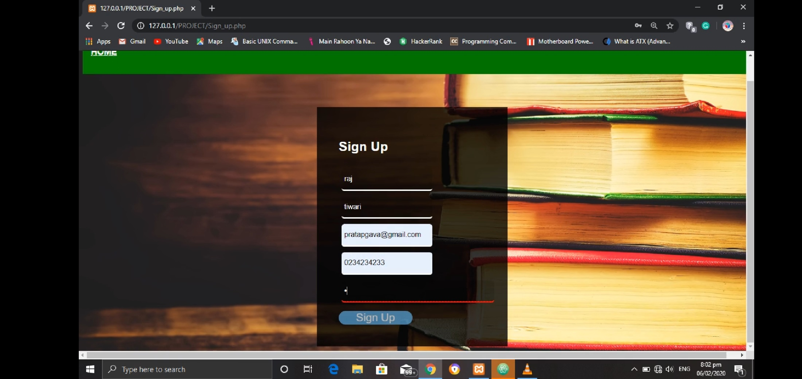

Slide 34
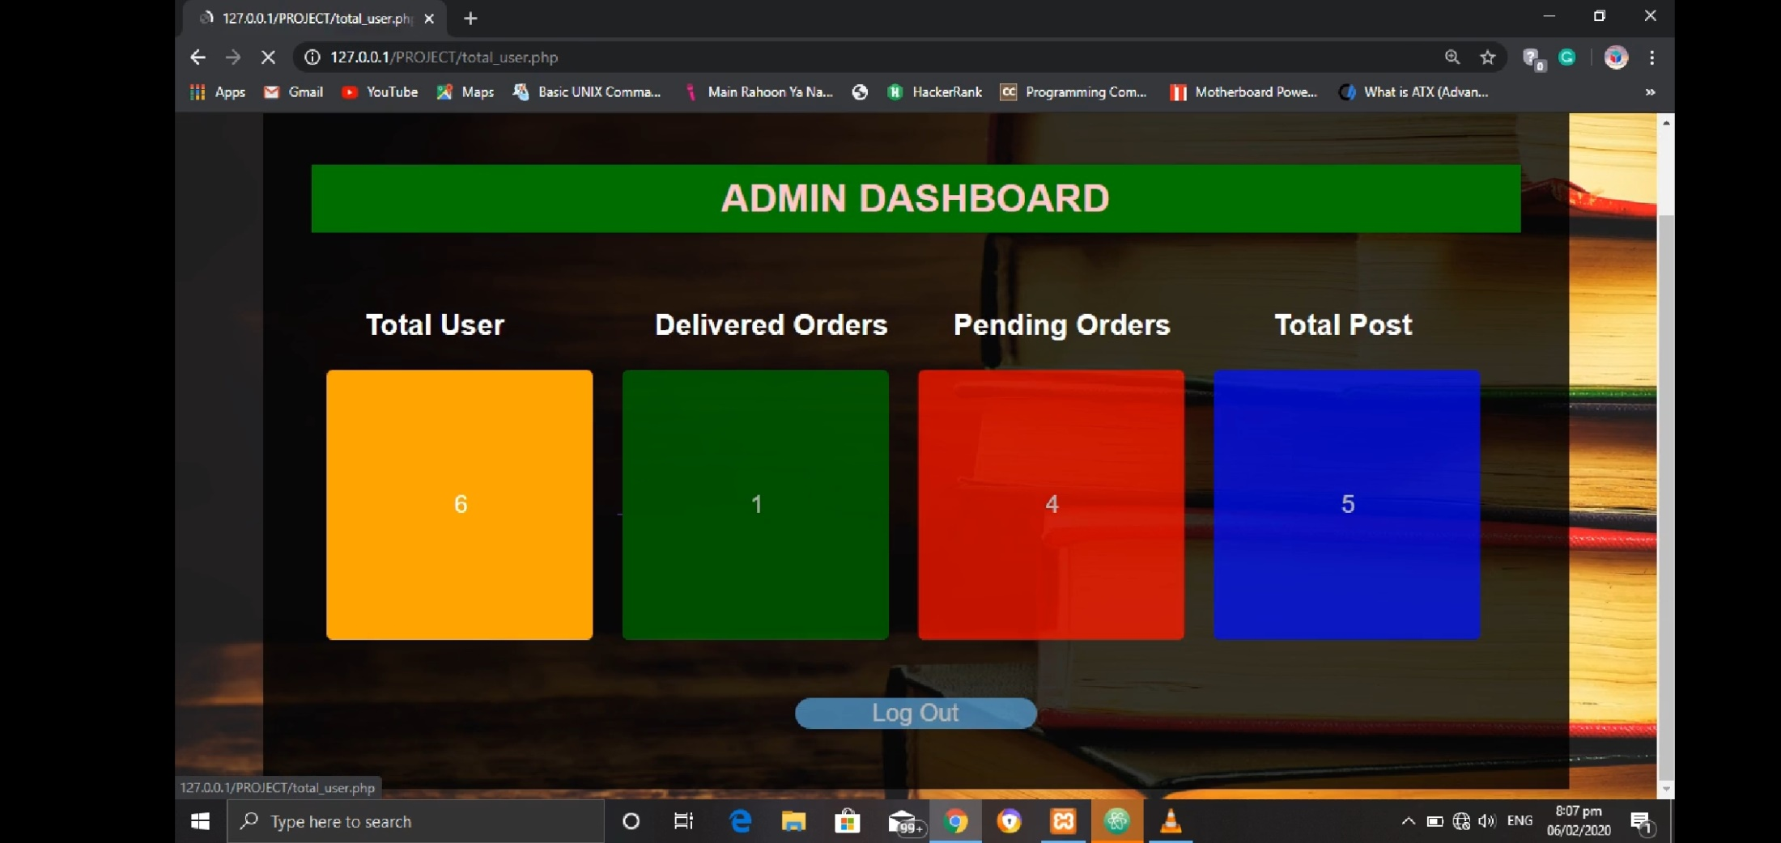

Slide 35
THANK YOU

